Slide 1
Tips for having a better LIVE lecture experience in Echo360
Use Google Chrome as a browser.
Under Preferences→ About Chrome → ensure that the app is up to date.

Slide 2
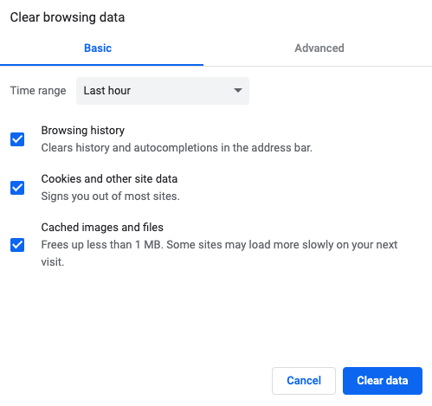
3. Under Preferences, Privacy and Security, ensure that you check the box to clear cached images and files

Slide 3
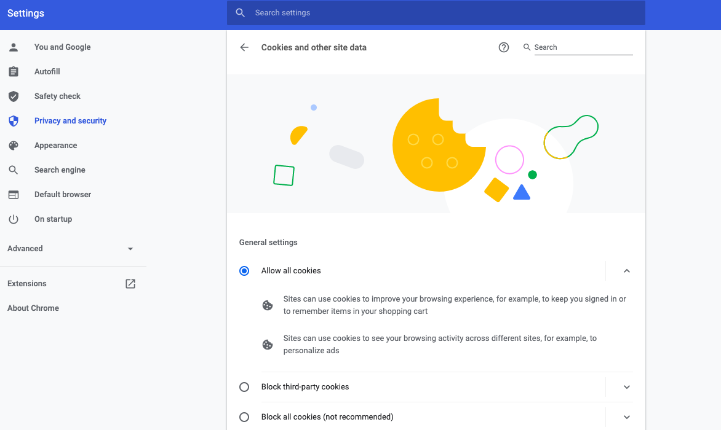
4. Under Preferences, Privacy and Security, allow all cookies.

